Slide 1


Big Data Programming: Python
Team 9
Keerti Suryawanshi
Vaishnavi Kanchan
Pooja Patil
Rutwik Patil
1

Slide 2

Introduction
The main Objective of the Project is to find the talented candidates for Software Company Doodle by analyzing the data points over the internet. This will help in achieving better results in a shorter amount of time and often with fewer resources relative to the goals.
2

Slide 3





Tools & Technologies used
PostgreSQL
HTML
CSS
Flask
Visual Studio Code
3

Slide 4
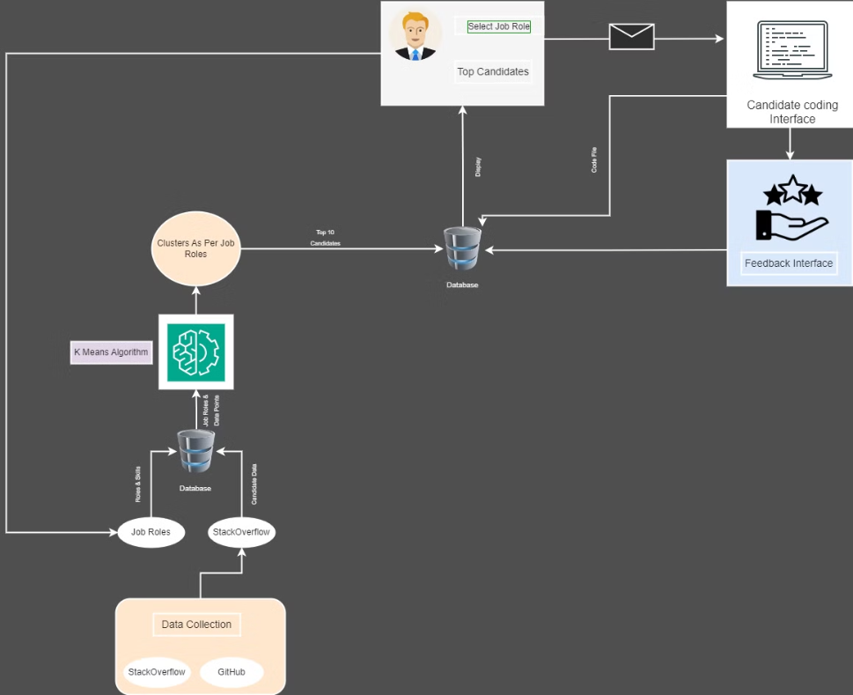
Architecture Diagram
4

Slide 5

Candidate Selection
Load Data
Preprocess Data
Feature Preparation
Determine Optimal Clusters
K-Means Clustering
Analyze Clusters
Identify Job Role for Each Cluster
Select Top Candidates for specific
5

Slide 6
Doodle Recruiter
Job Recruiter
Selects job role in the interface.
Database
Fetches the data of job roles from database to select the candidate
Algorithm
Generates list of top matched candidates and saved to database
Interface
Reflects list of top candidates to the recruiter
Email
Shares a coding assessment invite
Recruiter
Analyses the code and sends interview invite.
6

Slide 7

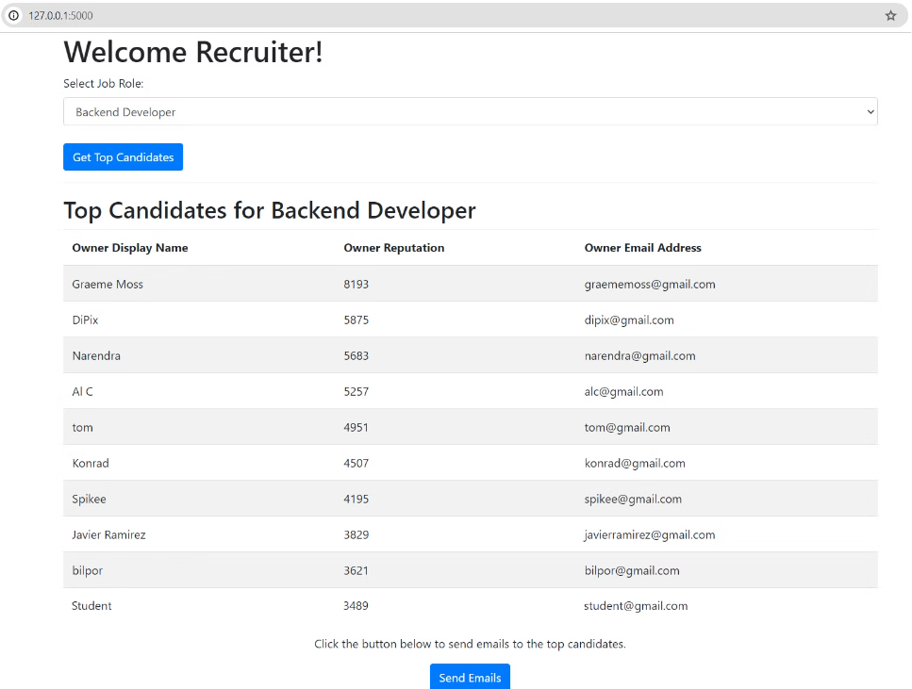
Recruiter Interface
7

Slide 8


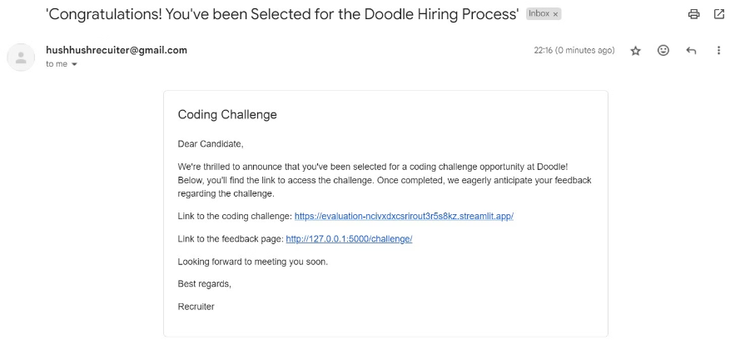
Sending Mails to Top Candidates.
Coding Test Mail
Feedback Mail
Automated emails inviting top candidates to complete a coding assessment.
Establishing a feedback loop for continuous improvement in candidate recruitment and assessment procedures.
8

Slide 9
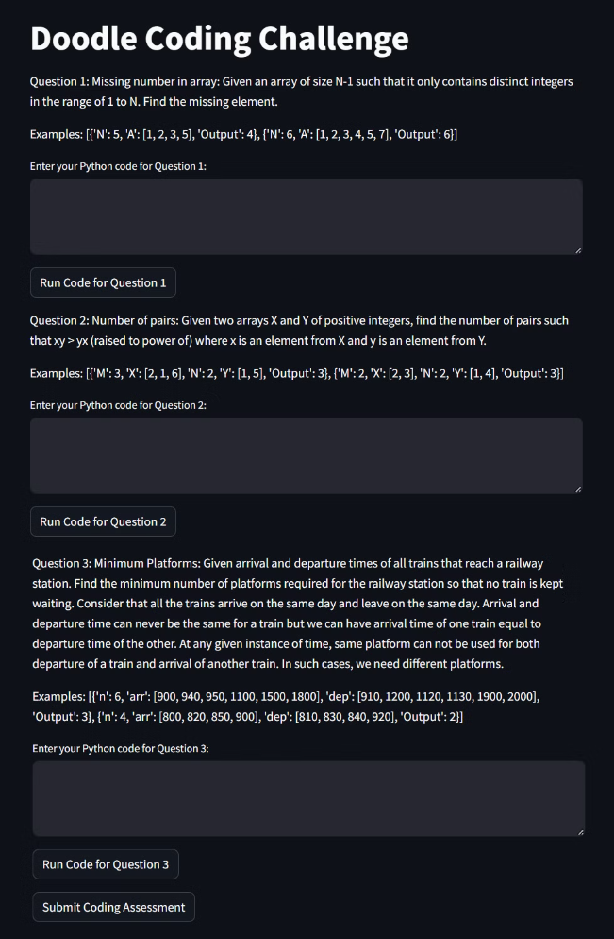
Doodle Coding Challenge with Three Python Questions
9

Slide 10
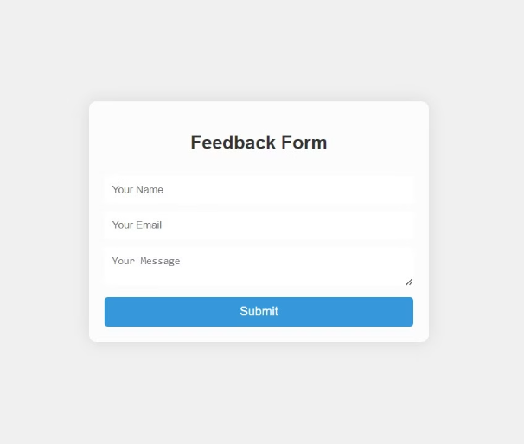
Candidate Selection Interface
10

Slide 11
Limitations
The data points obtained from Stackoverflow and GitHub could not be linked together as they don't have any common parameter between them.
Apart from these , there are other sources from where data can be crawled using API like LinkedIn , Hackerrank but those are not free.
11

Slide 12
Future Scope
Coding Evaluation System can be improvised by adding multiple compilers.
Recruiter should be able to provide feedback against the coding solution given by candidates.
12

Slide 13
Github -
https://github.com/Big-Data-Programming/bdp-oct23-exam-bdp_oct23_group9
13

Slide 14
Thank You!!
14

